Slide 1
Survey Report
mingxuan

Slide 2
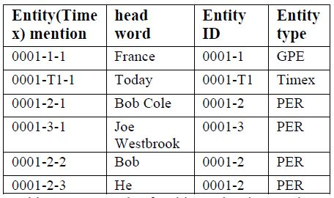
Some ACE terminology
Entity: an object or a set of objects in one of the semantic categories.
Entity mention: a reference to an entity.
Three murders occurred in France today, including the senseless slaying of Bob Cole and the assassination of Joe Westbrook. Bob was on his way home when he was attacked…
Notes:
在这一页就应该给一个例子，对每个定义进行说明。

Slide 3
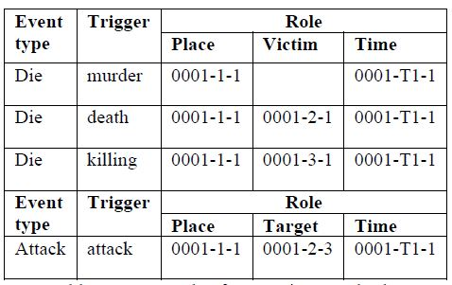
Some ACE terminology
Event mention: a phrase or sentence within which an event is described.
Event trigger: the main word that most clearly expresses an event occurrence.
Event mention arguments (roles): the entity mentions that are involved in an event mention, and their relation to the event.
Three murders occurred in France today, including the senseless slaying of Bob Cole and the assassination of Joe Westbrook. Bob was on his way home when he was attacked…
Notes:
在这一页就应该给一个例子，对每个定义进行说明。

Slide 4
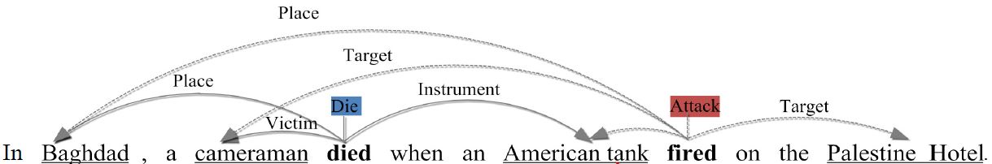
Definition of task
First: identify and classify triggers (instances) of a class of events.
Second: identify and classify arguments (participants and attributes) of each event.
Notes:
红色部分是依存关系，在这里是不需要的，因为只是阐述问题定义。在这里加上还容易把人搞晕。

Slide 5
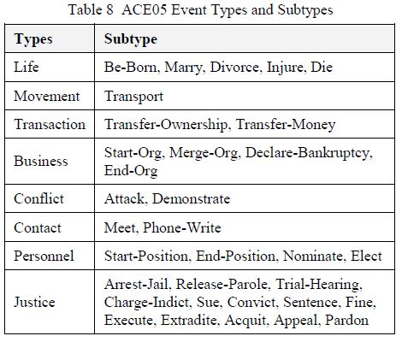
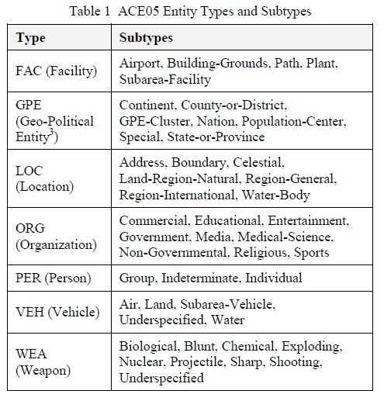
Definition of Type
Notes:
第六和第七页应该在第四页之前。这一页之后应该放第八页和第九页。

Slide 6
Definition of task
First: identify and classify triggers (instances) of a class of events.
Second: identify and classify arguments (participants and attributes) of each event.
Notes:
红色部分是依存关系，在这里是不需要的，因为只是阐述问题定义。在这里加上还容易把人搞晕。

Slide 7
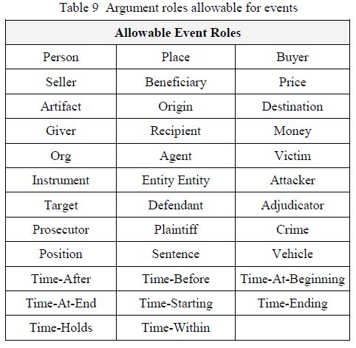
Definition of Role

Slide 8
Evaluation Metric
For trigger: event type, offsets match a reference trigger.
For argument: event type, offsets match any of the reference argument mentions.
For role: event type, offsets, and role match any of the reference argument mentions.

Slide 9
Data Set
ID: LDC2006D06 -- timex2norm
Number of documents: 599
Component:
Dev Set: randomly selected, 10 or 30
Test Set: same 40 newswire articles
Conversational Telephone Speech |  |  | 39
Usenet Newsgroups/Discussion Forum |  |  | 49
Newswire | 106 | Broadcast News | 226
Weblog | 119 | Broadcast Conversation | 60

Slide 10
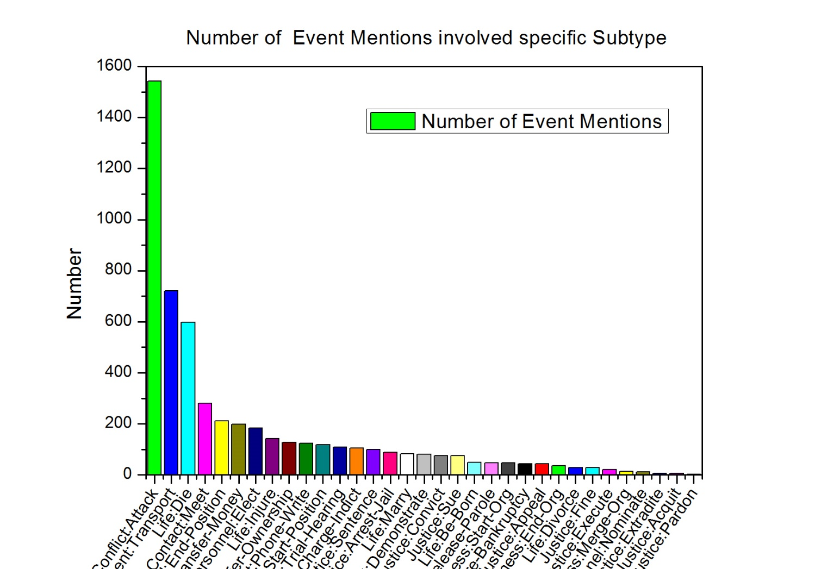
Analysis of Data Set
Number of event mentions in each sentence | Number of sentences | Percentage (%)
0 | 11630 | 74.523
1 | 2951 | 18.909
2 | 767 | 4.915
3 | 199 | 1.275
4 | 41 | 0.263
5 | 12 | 0.077
6 | 3 | 0.019
7 | 1 | 0.006
8 | 1 | 0.006
10 | 1 | 0.006
Total | 15606 | 100.000

Slide 11
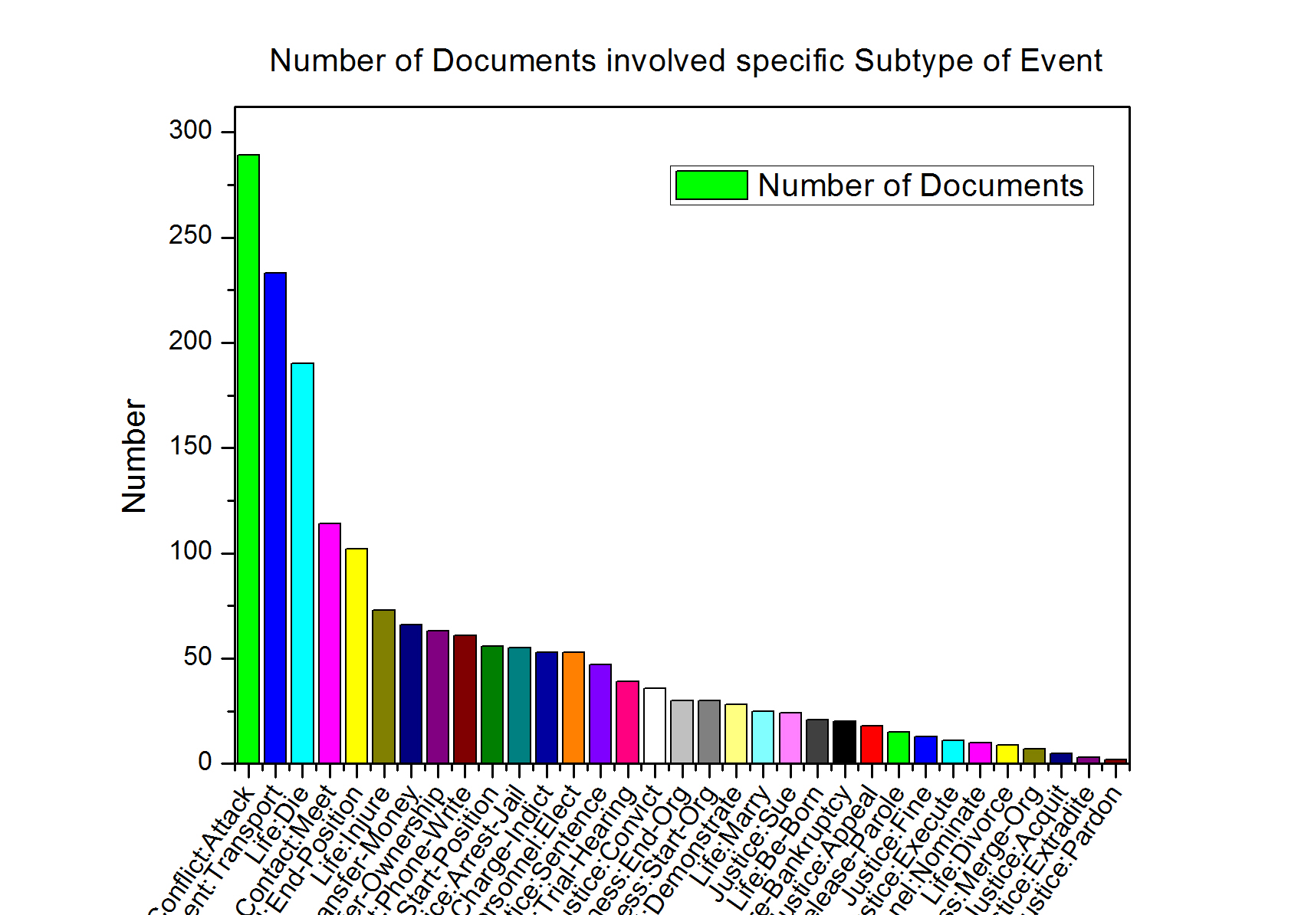
Analysis of Data Set

Slide 12
Current Methods
¹ One step: Identify and classify triggers and arguments in one step.
² Joint: Extract triggers and arguments together

Slide 13
Results
Methods | Trigger Identification(%) | Trigger Identification +Classification(%) | Argument Identification(%) | Argument Role(%)
 | P R F | P R F | P R F | P R F
05-Baseline (Jet) | N/A | 67.6 53.5 59.7 | 46.5 37.1 41.3 | 41.0 32.8 36.5
08-Ji's Cross-document | N/A | 60.2 76.4 67.3 | 55.7 39.5 46.2 | 51.3 36.4 42.6
10-Liao's Cross-event | N/A | 68.7 68.9 68.8 | 50.9 49.7 50.3 | 45.1 44.1 44.6
11-Hong's Cross-entity | N/A | 72.9* 64.3* 68.3* | 53.4* 52.9* 53.1* | 51.6* 45.5* 48.3*
13-Li's Joint structure | 76.9 65.0 70.4 | 73.7 * 62.3* 67.5*/65.6 | 69.8 * 47.9* 56.8* | 64.7 * 44.4* 52.7*/41.8
15-Chen's DMCNN | 80.4 67.7 73.5 | 75.6 63.6 69.1 | 68.8 51.9 59.1 | 62.2 46.9 53.5
15-Bronstein's Seed-based | N/A | 80.6 67.1 73.2 | N/A | N/A
* indicate that the proposed system directly uses the entity labels provided by ACE.

Slide 14
Evaluation Metric
For trigger: event type, offsets match a reference trigger.
For argument: event type, offsets match any of the reference argument mentions.
For role: event type, offsets, and role match any of the reference argument mentions.

Slide 15
Results
Methods | Trigger Identification(%) | Trigger Identification +Classification(%) | Argument Identification(%) | Argument Role(%)
 | P R F | P R F | P R F | P R F
05-Baseline (Jet) | N/A | 67.6 53.5 59.7 | 46.5 37.1 41.3 | 41.0 32.8 36.5
08-Ji's Cross-document | N/A | 60.2 76.4 67.3 | 55.7 39.5 46.2 | 51.3 36.4 42.6
10-Liao's Cross-event | N/A | 68.7 68.9 68.8 | 50.9 49.7 50.3 | 45.1 44.1 44.6
11-Hong's Cross-entity | N/A | 72.9* 64.3* 68.3* | 53.4* 52.9* 53.1* | 51.6* 45.5* 48.3*
13-Li's Joint structure | 76.9 65.0 70.4 | 73.7 * 62.3* 67.5*/65.6 | 69.8 * 47.9* 56.8* | 64.7 * 44.4* 52.7*/41.8
15-Chen's DMCNN | 80.4 67.7 73.5 | 75.6 63.6 69.1 | 68.8 51.9 59.1 | 62.2 46.9 53.5
15-Bronstein's Seed-based | N/A | 80.6 67.1 73.2 | N/A | N/A
* indicate that the proposed system directly uses the entity labels provided by ACE.

Slide 16
Jet -- Grishman (ACE 05)
Notes:
仍然缺JET系统的原始描述。

Slide 17
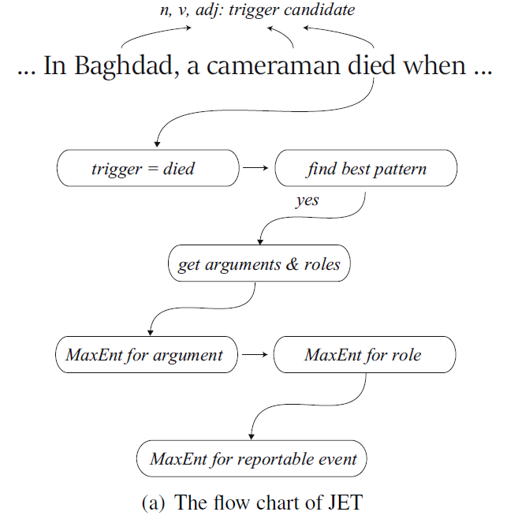
Framework
The system combines pattern matching with statistical models.
Patterns for trigger identification: sequences of constituent heads separating the trigger and arguments.
Argument Classifier: to distinguish arguments of a potential trigger from non-arguments.
Role Classifier: to classify arguments by argument role.
Reportable-Event Classifier (Trigger Classifier): Given a potential trigger, an event type, and a set of arguments, to determine whether there is a reportable event mention.

Slide 18
Refining Event Extraction through Cross-document Inference -- Heng Ji (ACL 08)
Notes:
仍然缺JET系统的原始描述。

Slide 19
Motivation [Consistency Learning]
One Trigger Sense Per Cluster
For a collection of topically-related documents, the distribution of triggers may be much more convergent.
One Argument Role Per Cluster
In other words, each entity plays the same argument role, or no role, for events with the same type in a collection of related documents.

Slide 20
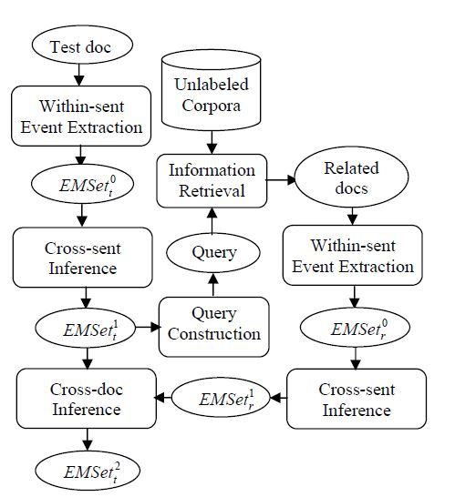
How to use motivation
Using document-wide consistency to remove or adjust triggers and arguments.
Using cluster-wide consistency to remove or adjust triggers and arguments.

Slide 21
Pros and Cons
Pros:
Based on the hypothesis of “One Sense Per Discourse”, author extends the scope of “discourse” from one single document to a cluster of topically-related documents.
Except for cluster-wide consistency, author also utilizes document-wide consistency.
Cons:
Some specific cases will be removed or adjusted.
Solution: fine-grained event type
Some unlabeled triggers or arguments will be wrong labeled. -- low precision
Solution: Not just label all unlabeled mention.

Slide 22
Results
Methods | Trigger Identification(%) | Trigger Identification +Classification(%) | Argument Identification(%) | Argument Role(%)
 | P R F | P R F | P R F | P R F
05-Baseline (Jet) | N/A | 67.6 53.5 59.7 | 46.5 37.1 41.3 | 41.0 32.8 36.5
08-Ji's Cross-document | N/A | 60.2 76.4 67.3 | 55.7 39.5 46.2 | 51.3 36.4 42.6
10-Liao's Cross-event | N/A | 68.7 68.9 68.8 | 50.9 49.7 50.3 | 45.1 44.1 44.6
11-Hong's Cross-entity | N/A | 72.9* 64.3* 68.3* | 53.4* 52.9* 53.1* | 51.6* 45.5* 48.3*
13-Li's Joint structure | 76.9 65.0 70.4 | 73.7 * 62.3* 67.5*/65.6 | 69.8 * 47.9* 56.8* | 64.7 * 44.4* 52.7*/41.8
15-Chen's DMCNN | 80.4 67.7 73.5 | 75.6 63.6 69.1 | 68.8 51.9 59.1 | 62.2 46.9 53.5
15-Bronstein's Seed-based | N/A | 80.6 67.1 73.2 | N/A | N/A
* indicate that the proposed system directly uses the entity labels provided by ACE.

Slide 23
Event Extraction via Dynamic Multi-Pooling Convolutional Neural Network -- Yubo Chen (ACL 15)

Slide 24
Motivation [semi-supervised Learning]
Traditional Methods utilize a set of elaborately designed features which lack generalization and take a large amount of human effort.
This paper introduces a word-representation model to capture meaningful semantic regularities for words (lexical features) and adopt a framework based on a convolutional neural network (CNN) to capture sentence-level clues (Contextual features).

Slide 25
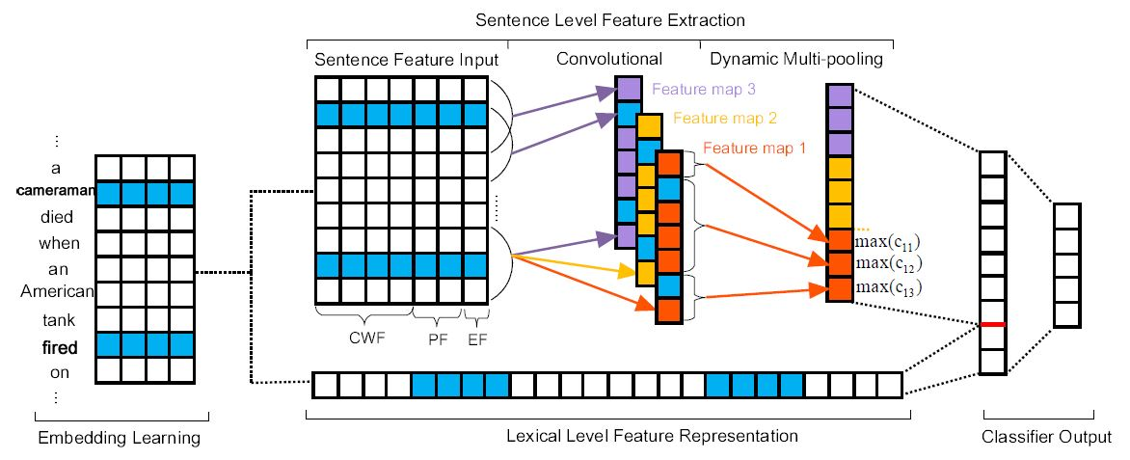
Architecture of argument classification
Notes:
可以告诉大家，这篇文章和NLP from Scratch

Slide 26
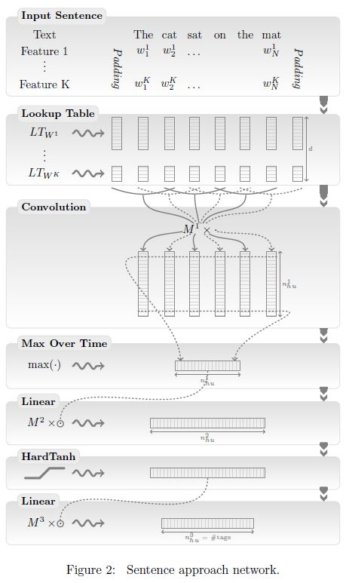
NLP from Scratch
Ronan Collobert et al., ICML 08, JMLR 11
A unified neural network architecture and learning algorithm that can be applied to various natural language processing tasks including: part-of-speech tagging, chunking, named entity recognition, and semantic role labeling.
Notes:
可以告诉大家，这篇文章和NLP from Scratch

Slide 27
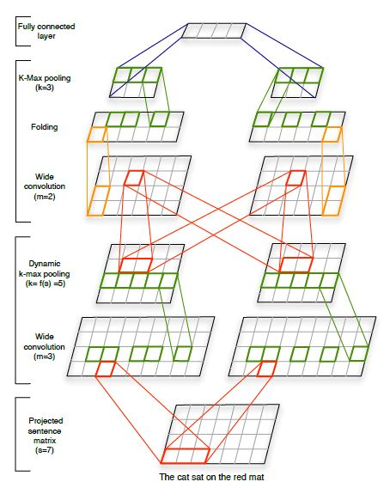
A CNN for Modelling Sentences
Nal Kalchbrenner et al., ACL 14
The network uses Dynamic k-Max Pooling, a global pooling operation over linear sequences.
Notes:
可以告诉大家，这篇文章和NLP from Scratch

Slide 28
Pros and Cons
Pros:
This paper utilizes new method to generate useful features which are simple and intuitive.
This paper can identify and classify triggers and arguments in one step.
Cons:
Some consistency and relationship can be used to improve the system performance.
New features may be used to improve the performance.

Slide 29
Results
Methods | Trigger Identification(%) | Trigger Identification +Classification(%) | Argument Identification(%) | Argument Role(%)
 | P R F | P R F | P R F | P R F
05-Baseline (Jet) | N/A | 67.6 53.5 59.7 | 46.5 37.1 41.3 | 41.0 32.8 36.5
08-Ji's Cross-document | N/A | 60.2 76.4 67.3 | 55.7 39.5 46.2 | 51.3 36.4 42.6
10-Liao's Cross-event | N/A | 68.7 68.9 68.8 | 50.9 49.7 50.3 | 45.1 44.1 44.6
11-Hong's Cross-entity | N/A | 72.9* 64.3* 68.3* | 53.4* 52.9* 53.1* | 51.6* 45.5* 48.3*
13-Li's Joint structure | 76.9 65.0 70.4 | 73.7 * 62.3* 67.5*/65.6 | 69.8 * 47.9* 56.8* | 64.7 * 44.4* 52.7*/41.8
15-Chen's DMCNN | 80.4 67.7 73.5 | 75.6 63.6 69.1 | 68.8 51.9 59.1 | 62.2 46.9 53.5
15-Bronstein's Seed-based | N/A | 80.6 67.1 73.2 | N/A | N/A
* indicate that the proposed system directly uses the entity labels provided by ACE.

Slide 30
Seed-Based Event Trigger Labeling: How far can event descriptions get us? -- Ofer Bronstein (ACL 15)

Slide 31
Framework [semi-supervised Learning]
Given the guideline for a new event type, this method collects these triggers into a list of seeds. (Per event type has 4.2 seeds in list on average, compared to 46 distinct trigger terms in the training corpus)
For instance, the ACE-2005 guidelines include:
“MEET Events include talks, summits, conferences, meetings, visits,. . . ”
followed by an example:
“Bush and Putin met this week. . . ”.

Slide 32
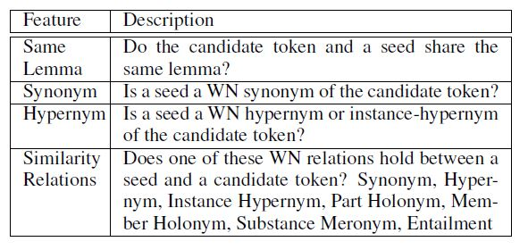
Framework [semi-supervised Learning]
Then, this method assesses each test text token similarity to the seed in list based on WordNet and lemma.

Slide 33
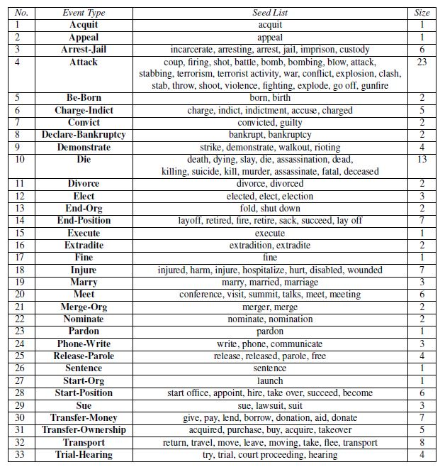
Seed Lists

Slide 34
Cons:
This method are highly dependent on WordNet.
Larger training didn’t improve results, possibly due to the small number of features.

Slide 35
Results
Methods | Trigger Identification(%) | Trigger Identification +Classification(%) | Argument Identification(%) | Argument Role(%)
 | P R F | P R F | P R F | P R F
05-Baseline (Jet) | N/A | 67.6 53.5 59.7 | 46.5 37.1 41.3 | 41.0 32.8 36.5
08-Ji's Cross-document | N/A | 60.2 76.4 67.3 | 55.7 39.5 46.2 | 51.3 36.4 42.6
10-Liao's Cross-event | N/A | 68.7 68.9 68.8 | 50.9 49.7 50.3 | 45.1 44.1 44.6
11-Hong's Cross-entity | N/A | 72.9* 64.3* 68.3* | 53.4* 52.9* 53.1* | 51.6* 45.5* 48.3*
13-Li's Joint structure | 76.9 65.0 70.4 | 73.7 * 62.3* 67.5*/65.6 | 69.8 * 47.9* 56.8* | 64.7 * 44.4* 52.7*/41.8
15-Chen's DMCNN | 80.4 67.7 73.5 | 75.6 63.6 69.1 | 68.8 51.9 59.1 | 62.2 46.9 53.5
15-Bronstein's Seed-based | N/A | 80.6 67.1 73.2 | N/A | N/A
* indicate that the proposed system directly uses the entity labels provided by ACE.

Slide 36
Review
Heng Ji (ACL 08): This paper employs a similar approach to propagate consistent event arguments across sentences and documents. [Consistency Learning]
Yubo Chen (ACL 15): This paper utilizes word embedding to automatically extract lexical-level features and utilize word embedding as well as dynamic multi-pooling CNN to extract sentence-level features. [semi-supervised Learning]
Ofer Bronstein (ACL 15): This paper uses annotation guidelines and WordNet to construct similarity-based classifier which is used to identify and classify trigger. [semi-supervised Learning]

Slide 37
Discussion
Notes:
在这时，应该再把前面讲过的几个相关工作，总结一遍。让你的听众再从整体角度回顾一下。
Discussion部分写的并不好，修改完这一版本，咱们再讨论一下。

Slide 38
Challenge
Training data is insufficient and heterogeneous.
Insufficient data cannot provide ample evidence to handle all cases in test set. e.g., Hong’s trigger F-score is low.
Across a heterogeneous document corpus, a particular verb can sometimes be trigger and sometimes not, and can represent different event types. e.g., conflict table in Liao’s method.
Good features are difficult to find
E.g., entity subtype consistency is useful to distinguish role of argument.

Slide 39
Solution
For training data
Using external resources: web and other corpus
Fine-grained: more precise subtype of entity
Related corpus (time, source)
Using good representation: embedding
Not sparsity
capture the semantics and similarity of the words
For good features
We can analyse dev set and find new patterns.
Using distributed representation to get task-related representation of features

Slide 40
What we can do?
We can use seed-based method to improve trigger F1 score.
We can use NER tagger to find effective argument candidates and utilize embedding to generate more accurate and more fine-grained entity subtype.
We can add new features to DMCNN, e.g., subtype of entity, binary indicator of distribution of event type.
New methods used in other DL architecture can be used in DMCNN.
Inference method used in previous systems can also be used in new system.

Slide 41
End

Slide 42
Using Document Level Cross-Event Inference to Improve Event Extraction

Slide 43
Motivation [Collective Learning]
If we first tag the easier cases, and use such knowledge to help tag the harder cases, we might get better overall performance.
Strong Consistency
Within a document, if one instance of a word triggers an event, other instances of the same word will trigger events of the same type. 99.4%
Normally one entity, if it appears as an argument of multiple events of the same type in a single document, is assigned the same role each time. 97%
Strong Relationship
When a event type appears in a document, some other certain event types appear in the same document.
When entities participate in event of certain type with a certain role, they will play limited role in limited event.

Slide 44
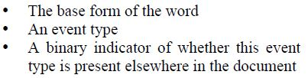
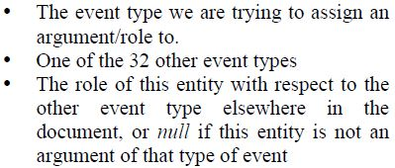
How to use motivation
To take advantage of cross-event relationships, author trains two additional MaxEnt classifiers, then use these classifiers to infer additional events and event arguments.
Features of Trigger Classifier:
1 & 2 reflect strong consistency of trigger
2 & 3 reflect strong relationship of trigger
1 & 2 reflect strong consistency of role
2 & 3 reflect strong relationship of role
Features of Argument (Role) Classifier:

Slide 45
Pros and Cons
Pros:
Author utilizes document level information and does not limit themselves to information about events of the same type. (compared with ji’s work)
Do not use external resources.
Cons:
Some specific cases violate the strong consistency and relationship.

Slide 46
Results
Methods | Trigger Identification(%) | Trigger Identification +Classification(%) | Argument Identification(%) | Argument Role(%)
 | P R F | P R F | P R F | P R F
05-Baseline (Jet) | N/A | 67.6 53.5 59.7 | 46.5 37.1 41.3 | 41.0 32.8 36.5
08-Ji's Cross-document | N/A | 60.2 76.4 67.3 | 55.7 39.5 46.2 | 51.3 36.4 42.6
10-Liao's Cross-event | N/A | 68.7 68.9 68.8 | 50.9 49.7 50.3 | 45.1 44.1 44.6
11-Hong's Cross-entity | N/A | 72.9* 64.3* 68.3* | 53.4* 52.9* 53.1* | 51.6* 45.5* 48.3*
13-Li's Joint structure | 76.9 65.0 70.4 | 73.7 * 62.3* 67.5*/65.6 | 69.8 * 47.9* 56.8* | 64.7 * 44.4* 52.7*/41.8
15-Chen's DMCNN | 80.4 67.7 73.5 | 75.6 63.6 69.1 | 68.8 51.9 59.1 | 62.2 46.9 53.5
15-Bronstein's Seed-based | N/A | 80.6 67.1 73.2 | N/A | N/A
* indicate that the proposed system directly uses the entity labels provided by ACE.

Slide 47
Using Cross-Entity Inference to Improve Event Extraction
Notes:
Yu Hong的工作可以放在backup slide部分。重点介绍其他工作。

Slide 48
Motivation
Strong Entity Consistency:
If one entity mention appears in a type of event, other entity mentions of the same type will appear in similar events, and even use the same word to trigger the events.
Strong Role Consistency:
Entities of the same type normally play the same role, especially in the event mentions of the same type.

Slide 49
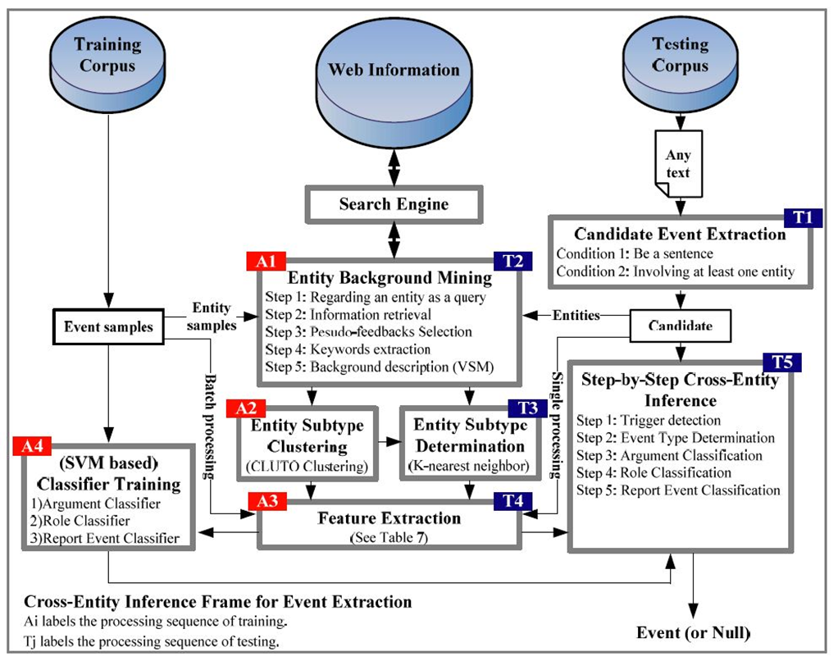
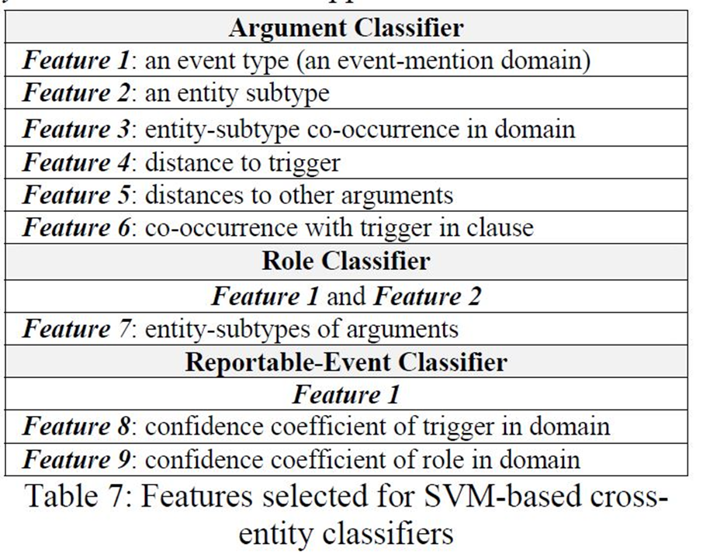
How to use motivation
1. Divide the ACE entity type into more cohesive subtype.
2. Construct three SVM classifier based on entity subtype and event type.

Slide 50
Pros and Cons
Pros:
This paper found that the entities within a sentence, as the most important local information, actually contain sufficient clues for event detection.
The features of classifier are simple and intuitive.
Cons:
This paper instead directly uses the entity labels provided by ACE. The results will decrease if uses entity labels extracted by jet system.
Something can be done to improve the identification and classification of trigger,

Slide 51
Results
Methods | Trigger Identification(%) | Trigger Identification +Classification(%) | Argument Identification(%) | Argument Role(%)
 | P R F | P R F | P R F | P R F
05-Baseline (Jet) | N/A | 67.6 53.5 59.7 | 46.5 37.1 41.3 | 41.0 32.8 36.5
08-Ji's Cross-document | N/A | 60.2 76.4 67.3 | 55.7 39.5 46.2 | 51.3 36.4 42.6
10-Liao's Cross-event | N/A | 68.7 68.9 68.8 | 50.9 49.7 50.3 | 45.1 44.1 44.6
11-Hong's Cross-entity | N/A | 72.9* 64.3* 68.3* | 53.4* 52.9* 53.1* | 51.6* 45.5* 48.3*
13-Li's Joint structure | 76.9 65.0 70.4 | 73.7 * 62.3* 67.5*/65.6 | 69.8 * 47.9* 56.8* | 64.7 * 44.4* 52.7*/41.8
15-Chen's DMCNN | 80.4 67.7 73.5 | 75.6 63.6 69.1 | 68.8 51.9 59.1 | 62.2 46.9 53.5
15-Bronstein's Seed-based | N/A | 80.6 67.1 73.2 | N/A | N/A
* indicate that the proposed system directly uses the entity labels provided by ACE.

Slide 52
Joint Event Extraction via Structured Prediction with Global Features

Slide 53
Motivation
As a common drawback of the staged architecture, errors in upstream component are often compounded and propagated to the downstream classifiers.
By contrast, this paper proposes a joint framework based on structured prediction which extracts triggers and arguments together so that the local predictions can be mutually improved.

Slide 54


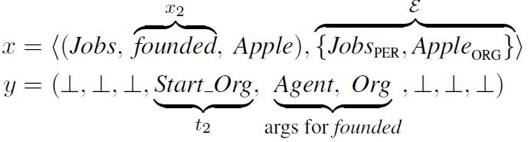
Symbol Description
Instance:
Configuration:
Example:

Slide 55

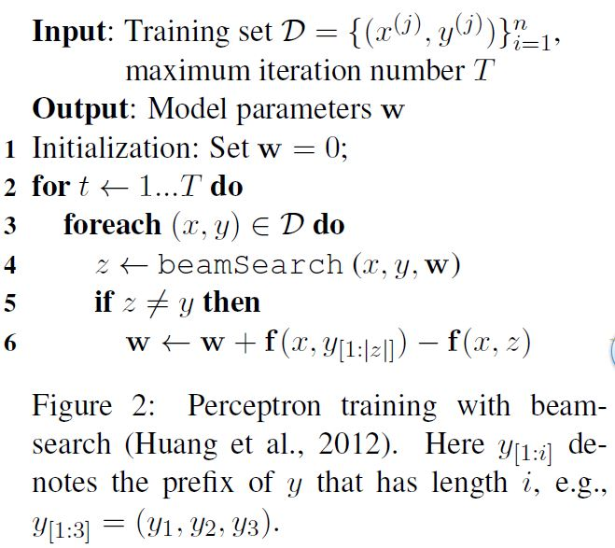
Architecture of joint system
Goal function:
Method: Beam-search with early-update strategy
Algorithm:

Slide 56
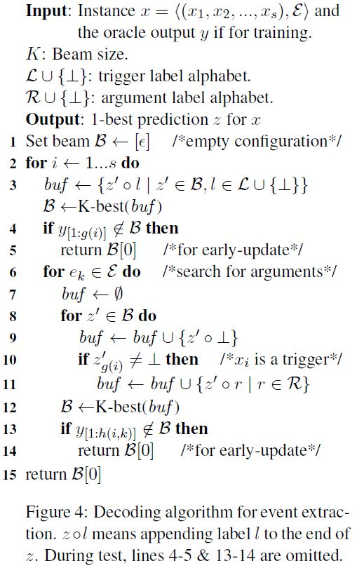
Process of Labeling -- BeamSearch

Slide 57
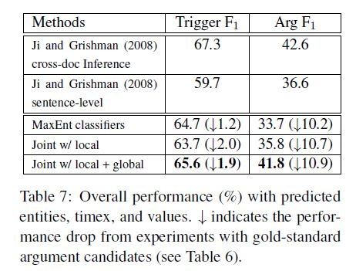
Cons:
As in Hong’s method, gold-standard argument candidates play a very important role in argument identification and classification.
If previous method utilize gold-standard entities, they may have impressive results.

Slide 58
Review
Jet: The system combines pattern matching with statistical models.
Heng Ji (ACL 08): This paper employs a similar approach to propagate consistent event arguments across sentences and documents.
Shasha Liao (ACL 10): This paper finds strong correlations among event types and a strong relationship between the roles in a document. They use document level cross-event information based on what they find to improve the performance.
Yu Hong (ACL 11): This paper finds the entity consistency in event type and role, so they regard entity subtype consistency as key feature to predict event mentions.
Qi Li (ACL 13): This paper proposes a joint framework based on structured prediction which extracts triggers and arguments together so that the local predictions can be mutually improved.
Yubo Chen (ACL 15): This paper utilizes word embedding to automatically extract lexical-level features and utilize word embedding as well as dynamic multi-pooling CNN to extract sentence-level features.
Ofer Bronstein (ACL 15): This paper uses annotation guidelines and WordNet to construct similarity-based classifier which is used to identify and classify trigger

Slide 59
Results
Methods | Trigger Identification(%) | Trigger Identification +Classification(%) | Argument Identification(%) | Argument Role(%)
 | P R F | P R F | P R F | P R F
05-Baseline (Jet) | N/A | 67.6 53.5 59.7 | 46.5 37.1 41.3 | 41.0 32.8 36.5
08-Ji's Cross-document | N/A | 60.2 76.4 67.3 | 55.7 39.5 46.2 | 51.3 36.4 42.6
10-Liao's Cross-event | N/A | 68.7 68.9 68.8 | 50.9 49.7 50.3 | 45.1 44.1 44.6
11-Hong's Cross-entity | N/A | 72.9* 64.3* 68.3* | 53.4* 52.9* 53.1* | 51.6* 45.5* 48.3*
13-Li's Joint structure | 76.9 65.0 70.4 | 73.7 * 62.3* 67.5*/65.6 | 69.8 * 47.9* 56.8* | 64.7 * 44.4* 52.7*/41.8
15-Chen's DMCNN | 80.4 67.7 73.5 | 75.6 63.6 69.1 | 68.8 51.9 59.1 | 62.2 46.9 53.5
15-Bronstein's Seed-based | N/A | 80.6 67.1 73.2 | N/A | N/A
* indicate that the proposed system directly uses the entity labels provided by ACE.

Slide 60
Algorithm Category
Category | Methods | Framework | Features | External Resources
Pipeline | Ralph Grishman (ACE 05) Jet (Baseline) | Pipeline | Lexical Features, Contextual Features | No
 | Heng Ji (ACL 08) Cross-document Inference | Jet + Inference (Rules) [Consistency Learning] | within-document confidence, cross-document confidence | English TDT5
 | Shasha Liao (ACL 10) Cross-event Inference | Jet + Inference (Classifier) [Collective Learning] | event type, event type ditribution , role ditribution | No
 | Yu Hong (ACL 11) Cross-entity Inference | Pipeline with new features | event type, entity subtype, relation of entity subtype | Web
 | Yubo Chen (ACL 15) Dynamic Multi-Pooling CNN | Pipeline (two stages) + One step¹ [semi-supervised Learning] | local: candidate words, context tokens global: context-word, position, event-type | NYT corpus
 | Ofer Bronstein (ACL 15) Seed-Based Trigger Labeling | One step¹ (Just for trigger) | 4 binary features: Similarity with seeds in list. | WordNet
Joint | Qi Li (ACL 13) Joint structure | Joint² + One step¹ | 25 local features, 8 global features | No
Notes:
这个表总结的很好，但是可视化做的不够好，怎么能让人更加一目了然的读懂呢？
最好也把我放假前跟你总结的也加入一下：
（1）ACL’08叫做consistency learning，主要是利用报道同一件事情的不同文档（news cluster）；
（2）ACL’10叫做collective learning，主要是利用同一篇文档内的其他事件互相帮助抽取；
（3）ACL’15叫做semi-supervised learning，虽然是利用了CNN，但其实主要是利用了unlabeled data学习。

Slide 61
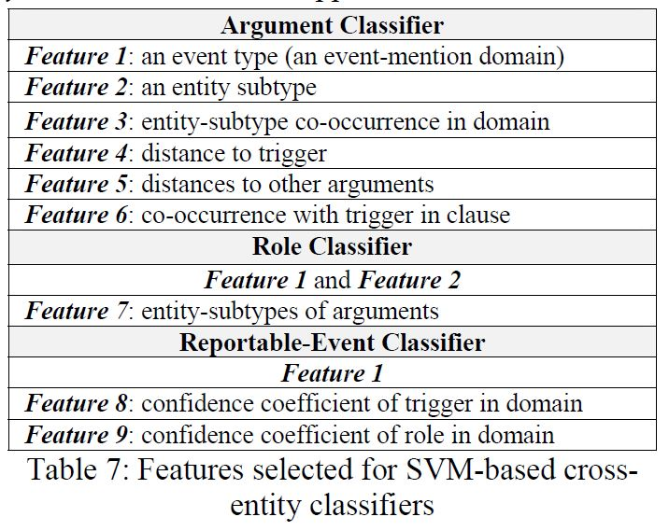
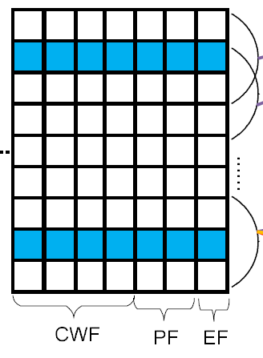
New Features
Features in Yu Hong’s method
Features for argument classification in DMCNN

Slide 62
